Slide 1
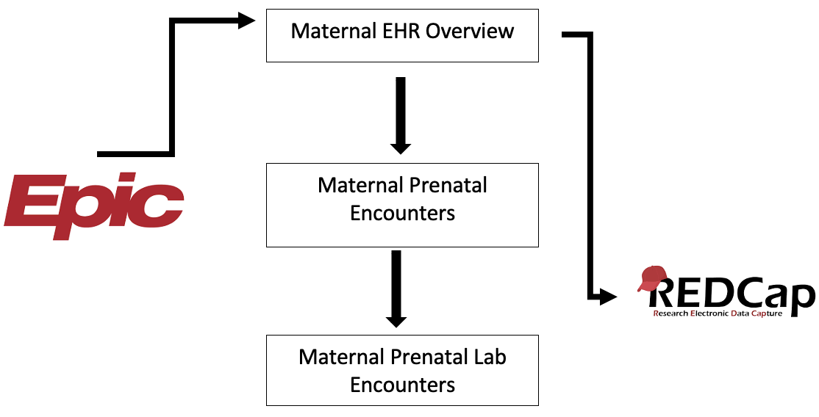

COMPARISON OF ROUTINELY COLLECTED PERINATAL ELECTRONIC HEALTH DATA WITH LONGITUDINAL CLINICAL RESEARCH DATA FROM THE BREASTFEEDING AND EARLY CHILD (BEACH) STUDY Abigail Vlasak, Nisha Chachad, Ke Xu, Magda Francois, Dominick J. Lemas, PhD. Department of Health Outcomes and Biomedical Informatics, University of Florida College of Medicine, Gainesville, FL.
INTRODUCTION
RESULTS
Breastfeeding populations are difficult to recruit.
The BEACH study population involves 4 arms with breastfeeding females.
Participant data was largely extracted from electronic health records.
Electronic health records (EHRs) have created new opportunities for researchers to collect clinical data on research participants using routinely collected EHR data.
Table 1. Descriptive Characteristics of BEACH participants
Table 2. Comparison of maternal BMI in EHR and BEACH study
 | NW | OW | Ob
Maternal Age
Gestational Age
Gender
Delivery Location -UF -North Florida -Other
 | NW | OW | Ob
Maternal BMI
UF Health
BEACH
OBJECTIVE
Demonstrate the value of using an electronic health record for streamlined database variable entry.
Compare self-reported BEACH survey BMI with EHR BMI.
Conclusions
The electronic health record can be a useful source of data extraction to allow better analysis of results.
METHODS
Next Steps
Directly querying EPIC for the data endpoints that had to be manually entered in a separate database in our study. Direct EHR query may be the most efficient way to collect subject’s metrics and study endpoints in the future.
Train other research assistants on the data inventory process
Further analysis of self reported and EPIC inputted data points using data informatic software
Figure 1. Summary of UF Health EHR data extraction
We were successful in developing a Redcap project for use in clinical and lab data extraction of participants. Three separate Redcap Instruments were created to collect specific sets of data about the subjects. We collected data on 50 participants enrolled in the BEACH study. The protocol was developed and tested across multiple team members. We found that once team members were familiar with the electronic health record, researchers were able to easily extract data into the Redcap database which facilitates further analysis of the study data.
Possible Result Display Options:
Flow chart of how EPIC is accessed and data then imported to research data base
Pie chart/ bar graph of how many of the participants delivered at UF health vs outside records
Explanation of how redcap can be used to collect data that is analyzable out of EPIC

